Slide 1
PSYC 741 Hierarchical Linear Modeling
Session 2 - Introduction and Assumptions of Multilevel Modeling

Slide 2
Overview of Today’s Class
Lecture and Discussion
Introduction to Multilevel Modeling
Assumptions of Multilevel Modeling
R tutorial
Data Wrangling & the tidyverse
In-Class Assignment

Slide 3
Introduction to Multilevel Modeling
Overview of Multilevel modeling
Types of multilevel effects
Fixed vs. random effects
MLM Notation

Slide 4
Introduction
What is multilevel modeling?
Data structured in some hierarchical fashion
E.g., Level 1 variables, Level 2 variables, Level 3 variables, etc.
Two common examples
Individuals clustered within groups
Repeated data clustered within individuals (e.g., longitudinal data)

Slide 5
The Problem
Dependency of the data violates assumptions of standard regression models
Not taking into account the clustering of multilevel data can drastically inflate the Type I error rate of regression coefficients (due to standard errors being smaller)
Notes:
The sample size directly affects the standard error (denominator of the formula)
If you don’t take into account clustering variable, the regression assumes each sample as an independent data point. Thus, it reduces the standard error -> inflate type 1 error (false positive)

Slide 6
MLM to the rescue!
Can account for clustering in data
While answering the following types of research questions
Group/cluster differences in means
Group/cluster differences in slopes (i.e., X → Y relationships)
Cross-level interactions
Different trajectories of change across time within individuals
Path analysis at individual and group levels

Slide 7
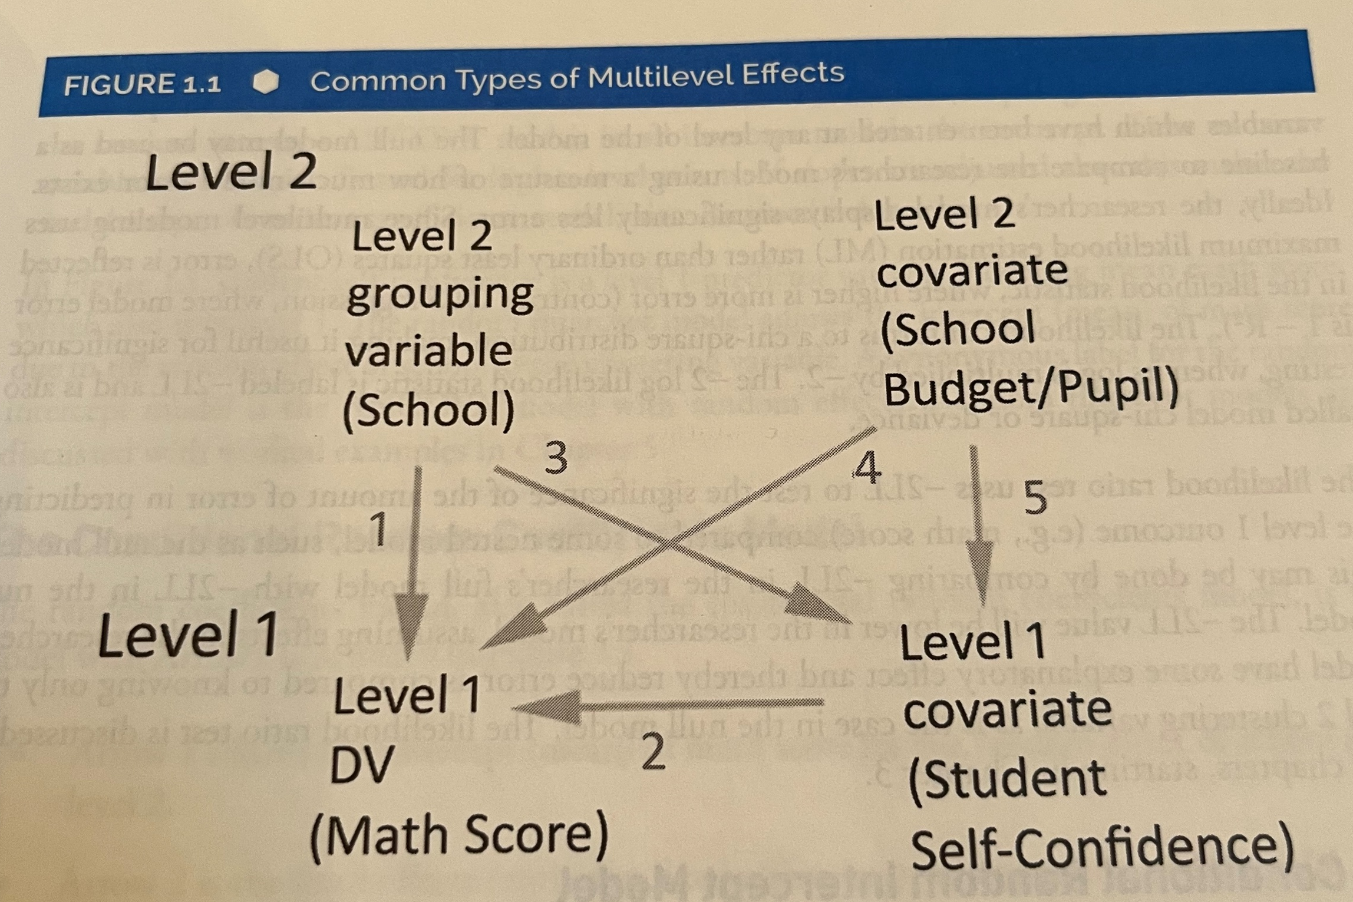
Types of Multilevel Effects

Slide 8
Fixed and Random Effects
Fixed Effects/Parameters
Similar interpretation as traditional (single-level) regression model parameters (i.e., intercept, slopes)
Random Effects/Parameters
The variance of the above parameters (i.e., intercept, slopes) across the higher-level groups/clusters

Slide 9
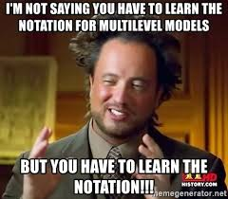
MLM Notation

Slide 10
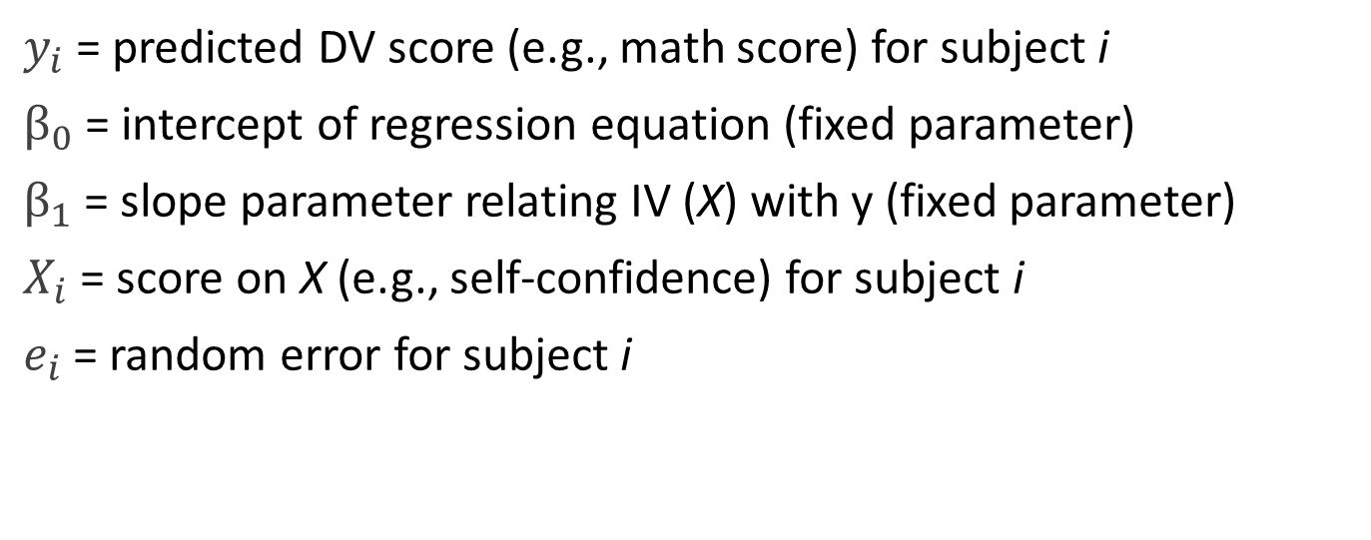

A single-level linear regression model
$$y_{i}=β_{0}+β_{1}X_{i}+ e_{i}$$
$y_{i}$ = predicted DV score (e.g., math score) for subject i
$β_{0}$ = intercept of regression equation (fixed parameter)
$β_{1}$ = slope parameter relating IV (X) with y (fixed parameter)
$X_{i}$ = score on X (e.g., self-confidence) for subject i
$e_{i}$ = random error for subject i

Slide 11
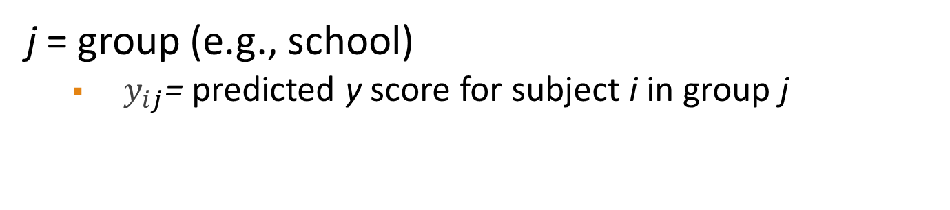
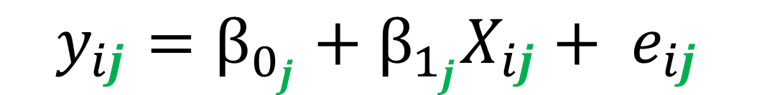
…with clustered/group data
$$y_{ij}=β_{0_{j}}+β_{1_{j}}X_{ij}+ e_{ij}$$
j = group (e.g., school)
$y_{ij}$= predicted y score for subject i in group j

Slide 12
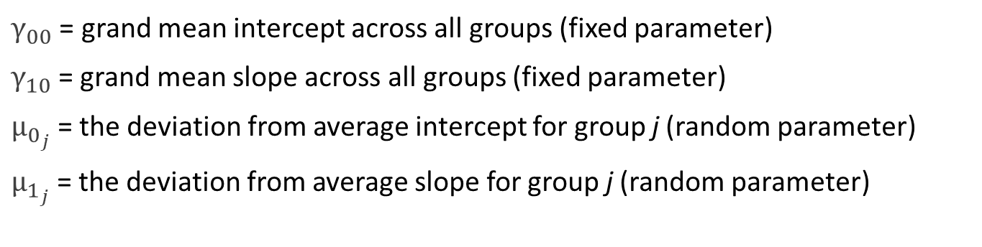



Random Intercepts and Random Slopes
Level 1
$$y_{ij}=β_{0_{j}}+β_{1_{j}}X_{ij}+ e_{ij}$$
Level 2
$$β_{0_{j}}=γ_{00}+ μ_{0_{j}}$$
Level 2
$$β_{1_{j}}=γ_{10}+ μ_{1_{j}}$$
$γ_{00}$ = grand mean intercept across all groups (fixed parameter)
$γ_{10}$= grand mean slope across all groups (fixed parameter)
$μ_{0_{j}}$= the deviation from average intercept for group j (random parameter)
$μ_{1_{j}}$= the deviation from average slope for group j (random parameter)

Slide 13



Reorganized Model
Level 1
$$y_{ij}=β_{0_{j}}+β_{1_{j}}X_{ij}+ e_{ij}$$
Level 2
$$β_{0_{j}}=γ_{00}+ μ_{0_{j}}$$
Level 2
$$β_{1_{j}}=γ_{10}+ μ_{1_{j}}$$
$$y_{ij}=γ_{00}+γ_{10}X_{ij}+μ_{0_{j}}+ {μ_{1_{j}}X_{ij}+ e}_{ij}$$
Level 2 equations can be substituted into the Level 1 equation to produce a single equation
With a single model fit!

Slide 14
Assumptions of Multilevel Modeling
Sample size issues
Regression assumptions
Other relevant issues and convergence problems
Covariance structure assumptions

Slide 15
Sample Size
Complex issue in MLM. Things to consider:
Research purpose and type of MLM
Is the focus on Level-1 effects or Level-2 effects? Fixed vs. random effects?
Desired statistical power for Level-2 and Level-1 effects and expected effect sizes
The number of parameters in the model
Maximum likelihood generally requires a larger sample size than OLS estimation
Convergence issues or estimation bias with very small sample sizes

Slide 16
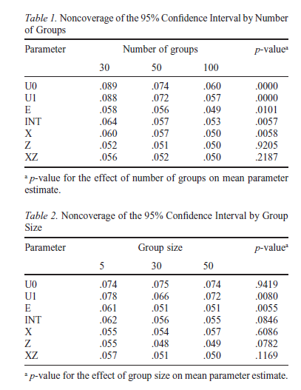
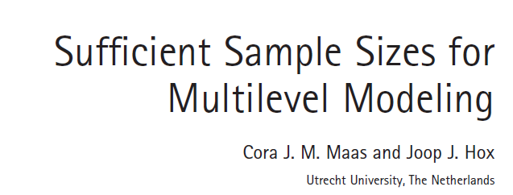
Sample Size

Slide 17
Assumptions of Regression still relevant for MLM
Linearity (for linear MLM)
No extreme outliers
No problematic multicollinearity
Residuals non-problematic (particularly for linear MLM)
Normally distributed;
linearly related to DV;
Homoscedasticity: variance of the error terms (residuals) is constant across all levels of the IV

Slide 18
Other Relevant Issues
Centering of predictors
Grand-mean centering vs. group-mean centering
Missing data
Imputing missing level-2 data?
Standardization
No betas and R-square values?

Slide 19

Convergence Issues
Your MLM may fail to converge or produce error messages like “non-positive definite Hessian matrix”
Results might still be outputted with a warning message, but interpret with caution
Common reasons:
Random effect(s) almost 0 in value
Correlations among random effects approaching 1
Small sample sizes (whether Level-2 or Level-1)

Slide 20

Convergence Issues
Common solutions:
Increase the number of iterations and convergence values
Increase the sample size (if possible and appropriate)
Respecify the model (e.g., reducing the # of parameters)
Dropping random parameters near 0
Reduce redundant predictors (e.g., if multicollinearity is present)
Adjust the covariance structure of the model
Use a different statistical software package

Slide 21
Covariance Structure Assumptions
Different ways to estimate the variance/covariance of the random effects in the model
Just FYI: only relevant when multiple random variances included in the model
Types (among others):
Variance components (VC): usually the default for random effects. Assumes independence (i.e., covariance of 0) among random effects.
Diagonal (DIAG): usually the default in repeated measures models
Unstructured (UN): all variances and covariances are estimated (i.e., no constraints). More complex as a result and more likely to lead to convergence issues.

Slide 22
Next Class
Lecture Topics:
The Null Model
Estimation of Multilevel Models
R
Introduction to MLM in R
Readings that will be discussed
Textbook Chapters 3 and 4
Contributing to your participation grade, make sure to respond to the Readings Feedback/Questions submission on Canvas

